Slide 1
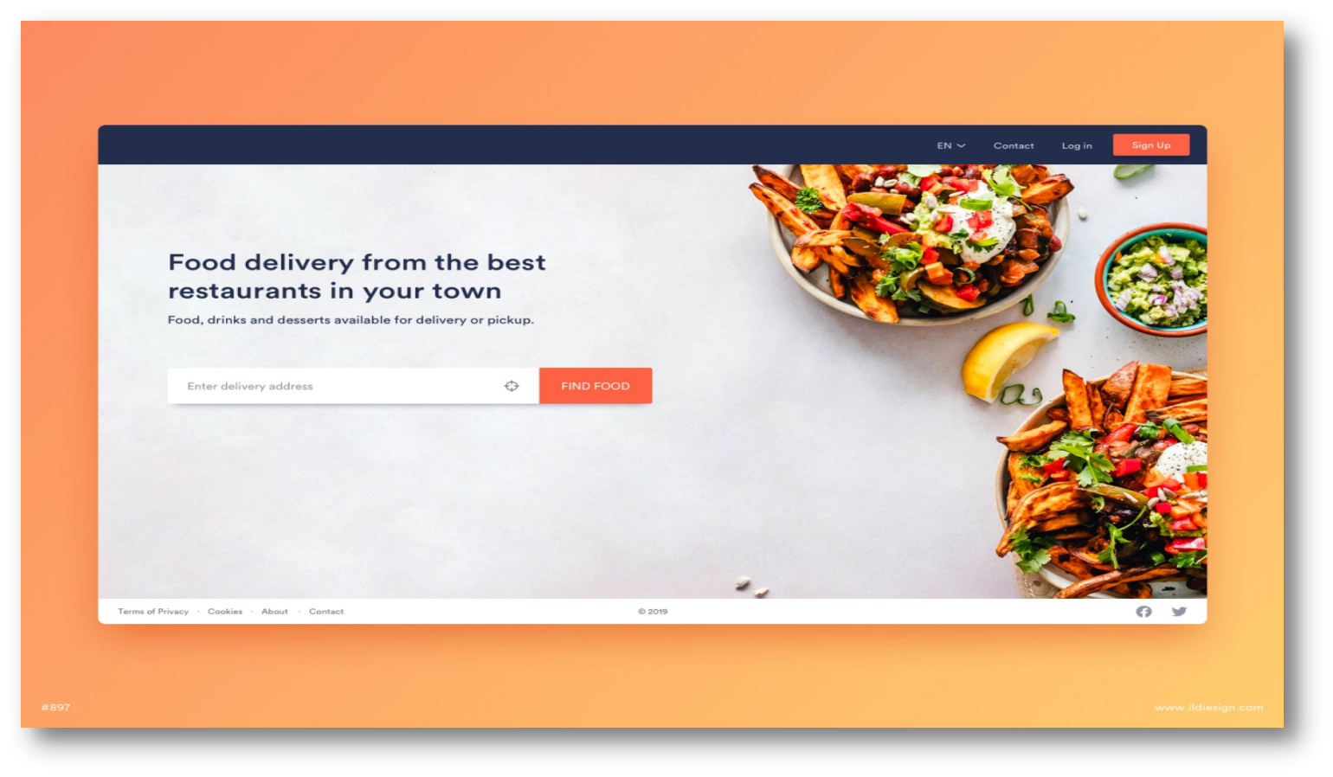
FOOD DELIVERY SYSTEM

Slide 2
DEVELOPER NAME
Name | Enrollment No
Harsh Khokhar | 2104030100353
Griva Kakadiya | 2104030100320
Chirag Koshti | 2104030100366

Slide 3
DATABASE DICTIONARY
Customer :-
FIELD NAME | DATA TYPE | SIZE | CONTRAINT
username | VARCHAR | 30 | PRIMARY KEY
fullname | VARCHAR | 30 | -
email | VARCHAR | 30 | -
contact | VARCHAR | 30 | -
address | VARCHAR | 50 | -
password | VARCHAR | 30 | -

Slide 4
DATABASE DICTIONARY
2. CONTACT :-
FIELD NAME | DATATYPE | SIZE | CONTARINT
name | VARCHAR | 250 | -
email | VARCHAR | 250 | -
mobile | VARCHAR | 250 | -
subject | VARCHAR | 250 | -
message | VARCHAR | 250 | -

Slide 5
DATABASE DICTIONARY
3. FOOD : -
FIELD NAME | DATATYPE | SIZE | CONTARINT
F_ID | INTEGER | 30 | PRIMARY KEY
Name | VARCHAR | 30 | -
Price | INTEGER | 30 | -
Description | VARCHAR | 200 | -
R_ID | INTEGER | 30 | FOREiGN KEY
Images_path | VARCHAR | 200 | -
Options | VARCHAR | 10 | -

Slide 6
DATA DICTIONARY
4. MANAGER :-
FIELD NAME | DATATYPE | SIZE | CONTARINT
Username | VARCHAR | 30 | PRIMARY KEY
Fullname | VARCHAR | 30 | -
Email | VARCHAR | 30 | -
Contact | VARCHAR | 30 | -
Address | VARCHAR | 50 | -
Password | VARCHAR | 30 | -

Slide 7
DATA DICTIONARY
5. ORDERS :-
FIELD NAME | DATATYPE | SIZE | CONTARINT
Order_ID | INTEGER | 30 | PRIMARY KEY
F_ID | INTEGER | 30 | FOREIGN KEY
Foodname | VARCHAR | 30 | -
Price | INTEGER | 30 | -
Quantity | INTEGER | 30 | -
Order_date | DATE | - | -
Username | VARCHAR | 30 | FOREIGN KEY
R_ID | INTEGER | 30 | FOREIGN KEY
Status | VARCHAR | 20 | -
D_ID | INTEGER | 30 | FOREIGN KEY
Order_time | TIME | - | -

Slide 8
DATA DICTIONARY
6. RESTAURANTS :-
FIELD NAME | DATATYPE | SIZE | CONTARINT
R_ID | INTEGER | 30 | PRIMARY KEY
Name | VARCHAR | 30 | -
Email | VARCHAR | 30 | -
Contact | VARCHAR | 30 | -
Address | VARCHAR | 50 | -
M_ID | VARCHAR | 30 | FOREIGN KEY

Slide 9
DATA DICTIONARY
7. DELIVERY BOY :-
FIELD NAME | DATATYPE | SIZE | CONTARINT
D_ID | INTEGER | 30 | PRIMARY KEY
Username | VARCHAR | 20 | -
Password | VARCHAR | 64 | -
Mobile_no | INTEGER | 10 | -
R_ID | INTEGER | 30 | FOREIGN KEY
Status | VARCHAR | 20 | -
Fullname | VARCHAR | 30 | -
Email | VARCHAR | 40 | -

Slide 10
DATA DICTIONARY
8. ORDERS_PRODUCT_DETAILS :-
FIELD NAME | DATATYPE | SIZE | CONTARINT
Order_ID | INTEGER | 30 | PRIMARY KEY
F_ID | INTEGER | 30 | FOREIGN KEY
Foodname | VARCHAR | 30 | -
Price | INTEGER | 30 | -
Quantity | INTEGER | 30 | -
Order_date | DATE | - | -
Username | VARCHAR | 30 | FOREIGN KEY
R_ID | INTEGER | 30 | FOREIGN KEY
Status | VARCHAR | 20 | -
D_ID | INTEGER | 30 | FOREIGN KEY
Order_time | TIME | - | -

Slide 11
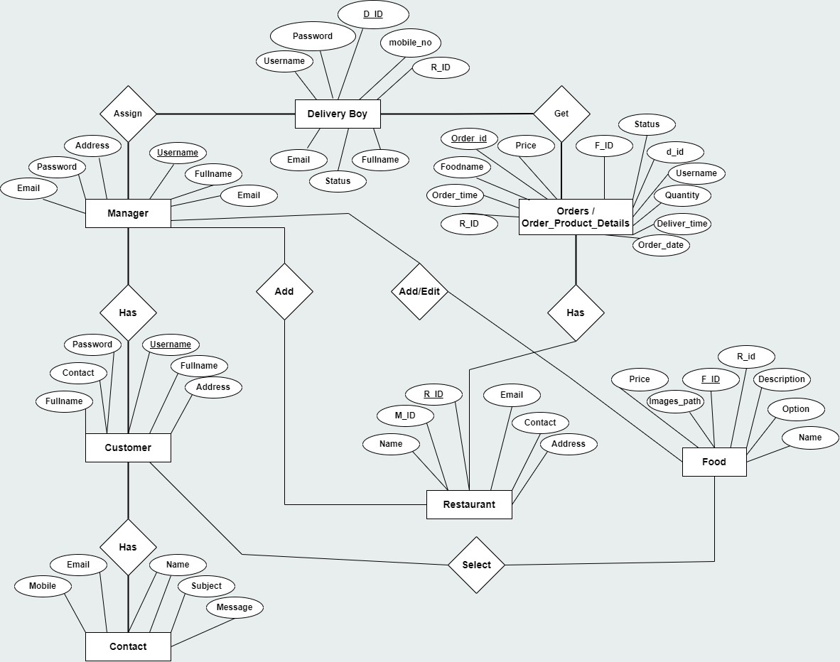
DIAGRAMS
ER-DIAGRAM :-

Slide 12
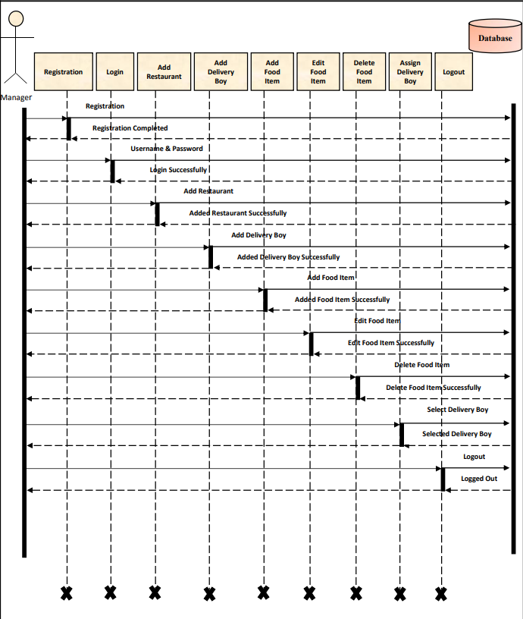
DIAGRMS
SEQUENCE DIAGRAM :-
1. Manager :-

Slide 13
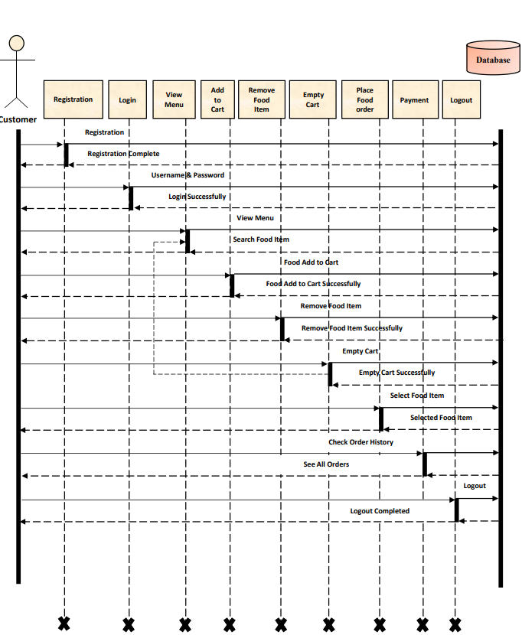
DIAGRAMS
2. Customer :-

Slide 14
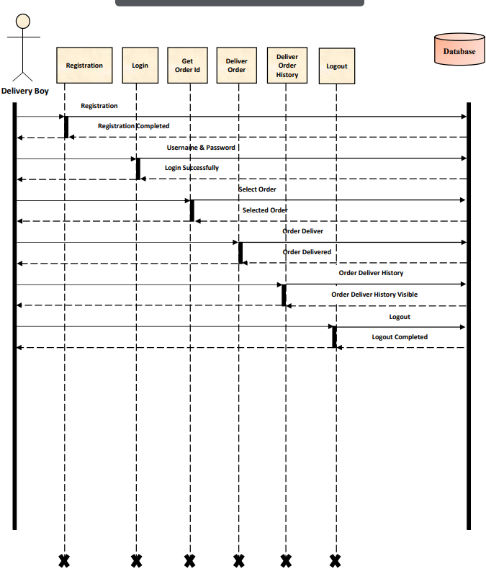
DIAGRAMS
3. Delivery boy :-

Slide 15
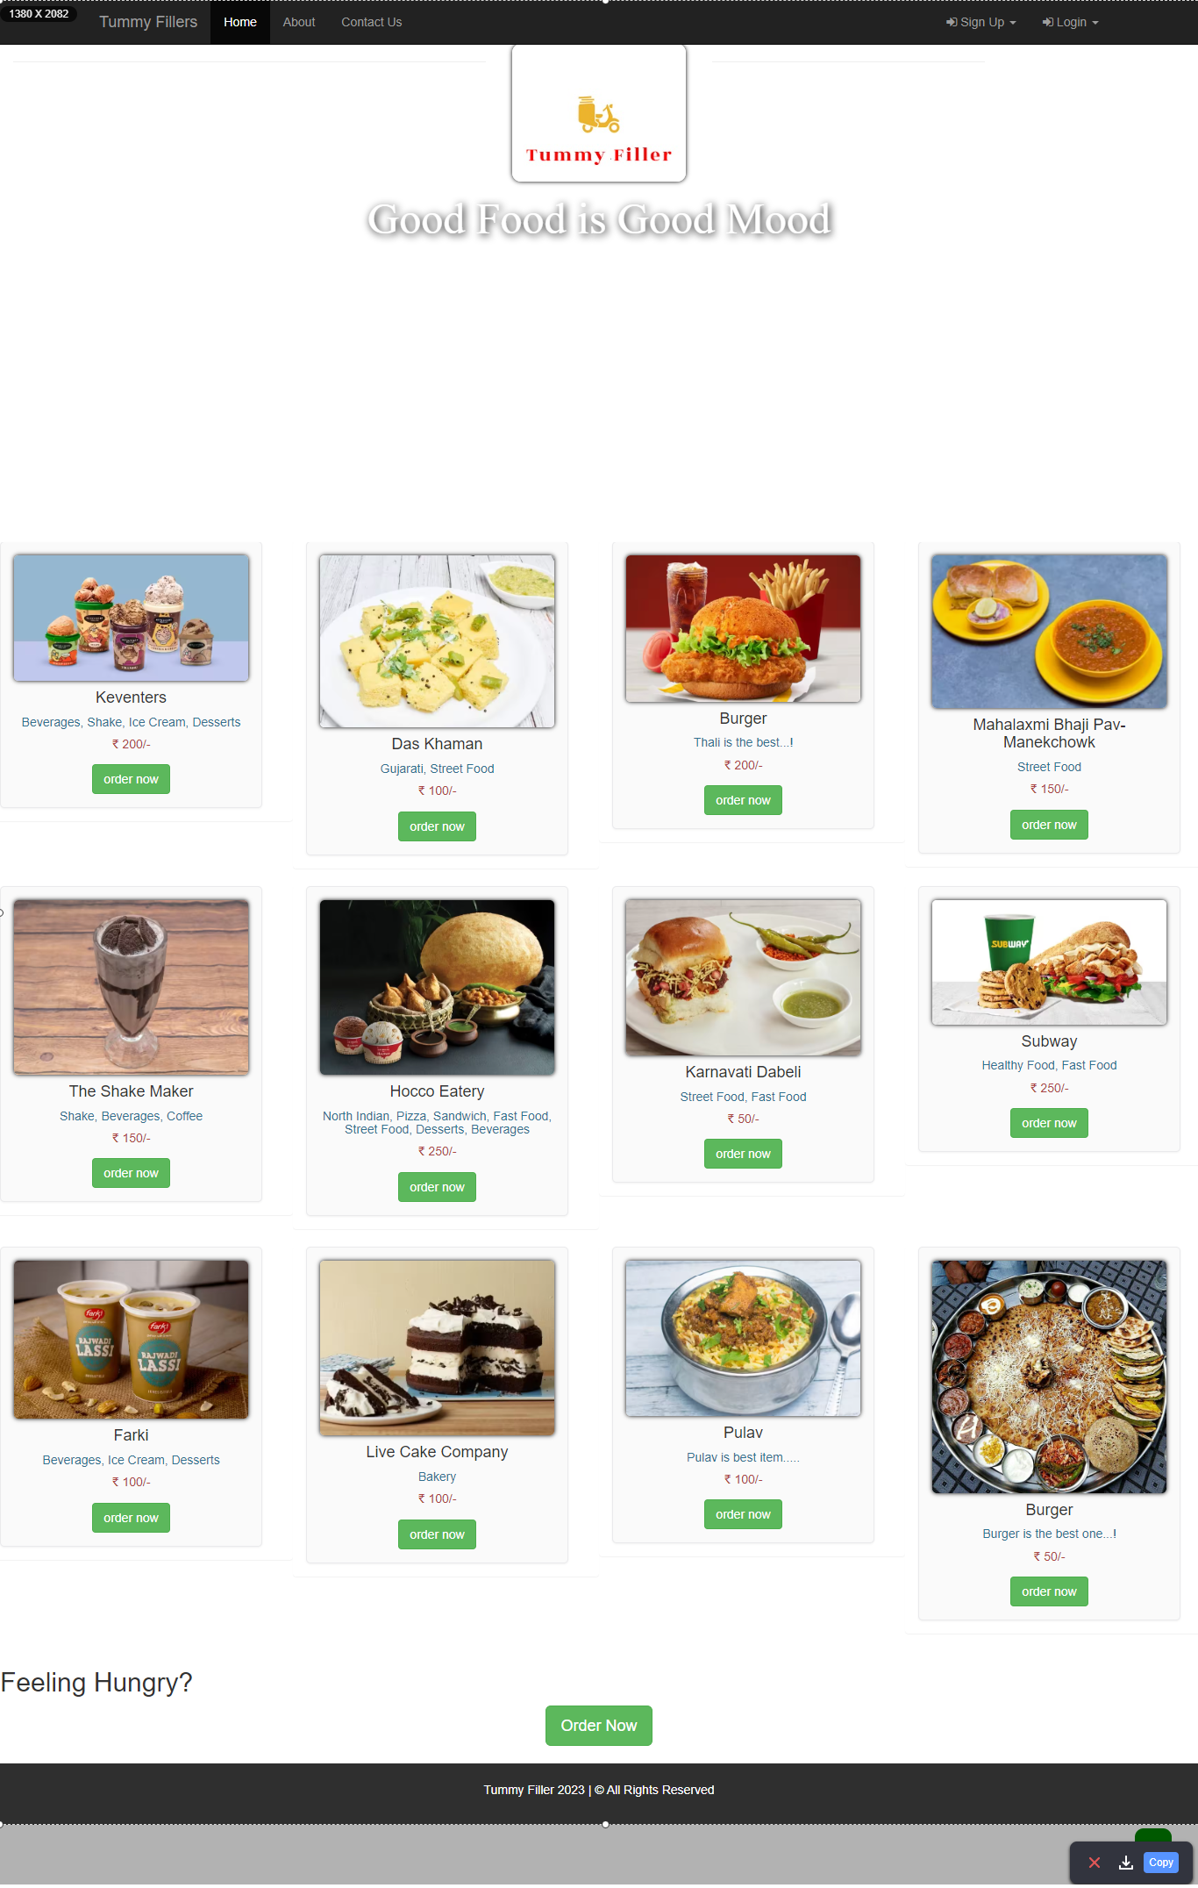
LAYOUT
Home Page :-
Provide a brief overview of the purpose of the home page.
Explain that it serves as the entry point for users into the food delivery system.

Slide 16
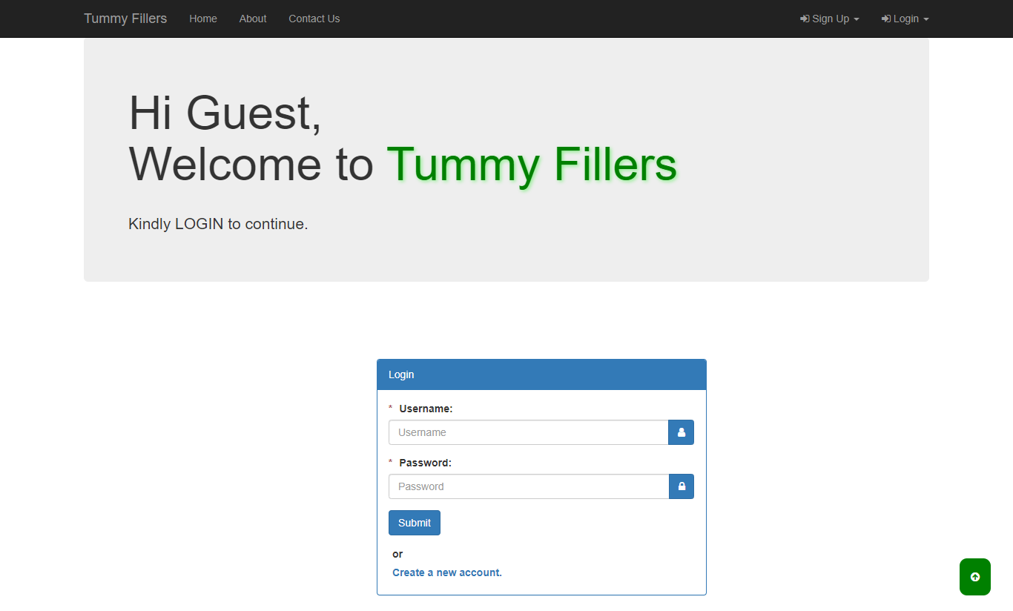
LAYOUT
Login Page :-
Provide a brief overview of the purpose of the login page.
Explain that it serves as the entry point for registered users to access their accounts.

Slide 17
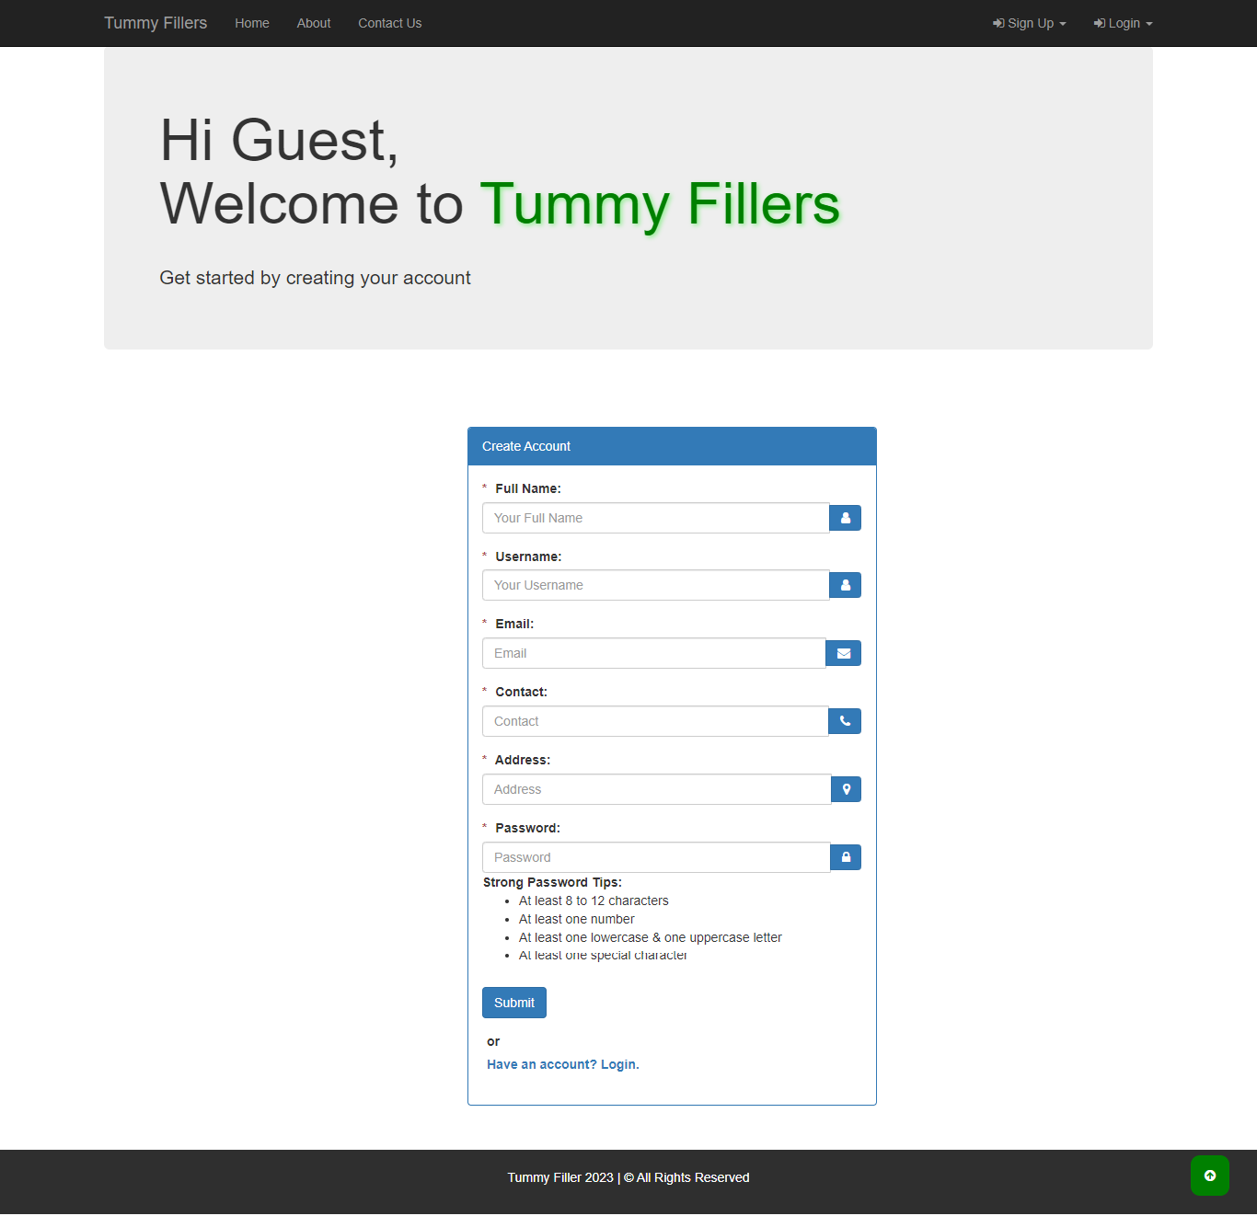
LAYOUT
Registration Page :-
Provide a brief overview of the purpose of the registration page.
Explain that it allows new users to create accounts and access the food delivery system.

Slide 18
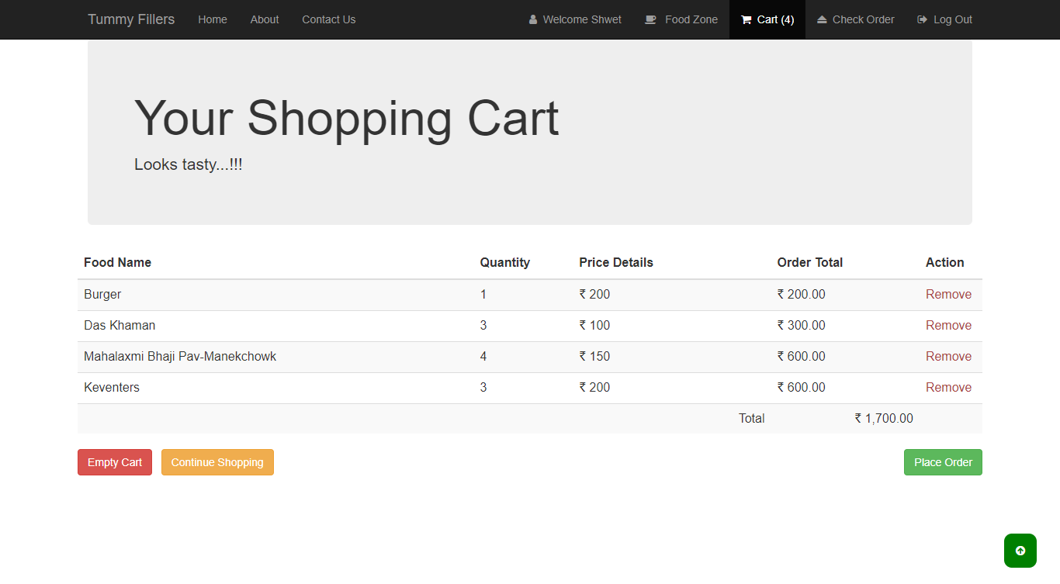
LAYOUT
Food Order Cart Page :-
Provide a brief overview of the purpose of the cart page.
Explain that it allows users to review and modify the items they've added to their order before completing the checkout process.

Slide 19
Thank You

